Slide 1
Chapter 1 : Basics of Remote Sensing

Slide 2
Scope of Remote Sensing
Geographer
Forester
Environmentalist
Geologist
ship captain
Farmer
Land use planner

Slide 3
Application of remote sensing
Land use and land cover
Land use and land over change detection
Agriculture
Forest management
Geology
Geo morphology
urban application
Hydrology
Pedology
groundwater assessment
ocean monitoring
Monitoring of atmospheric constituents

Slide 4
CONCEPT OF DATA

Slide 5
DEFINITION OF DATA
It is a fact-based Information which are further used for analysing a particular phenomena.

Slide 6
Quality of Data
Relevance
Accuracy
Reliability
Completeness
Timeliness

Slide 7
Types of Data
Remotely Sensed Data
In Situ Data

Slide 8

WHAT IS
REMOTE SENSING

Slide 9
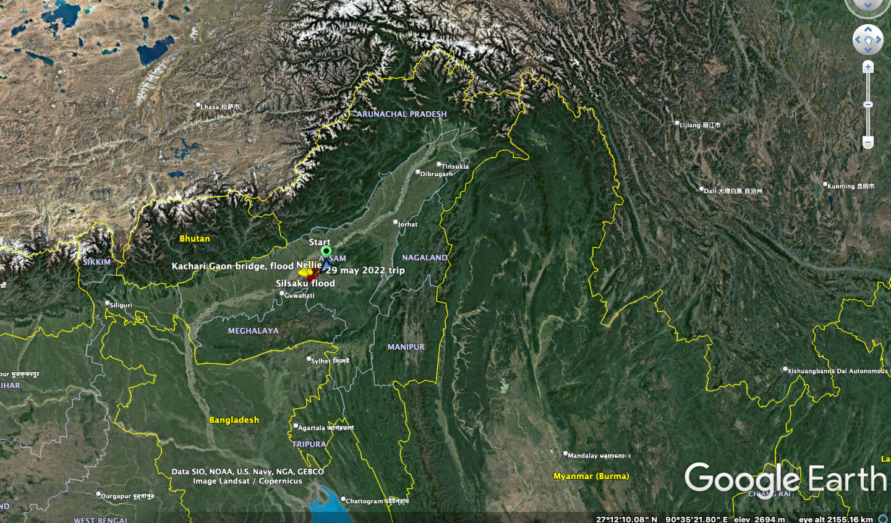
Definition of remote sensing
Remote sensing is the process of detecting and monitoring the physical characteristics of an area by measuring its reflected and emitted radiation at a distance (typically from satellite or aircraft).

Slide 10
Or
Another Definition
Remote sensing is a type of geospatial technology that samples emitted and reflected electromagnetic (EM) radiation from the Earth’s terrestrial, atmospheric, and aquatic ecosystems in order to detect and monitor the physical characteristics of an area without making physical contact.

